Slide 1
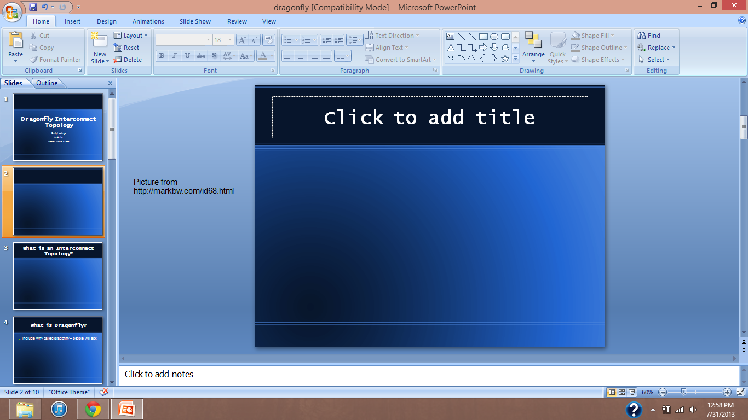
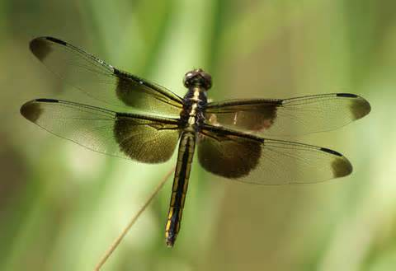
Dragonfly Interconnect Topology
Emily Hastings Anda Xu Mentor: David Bunde

Slide 2
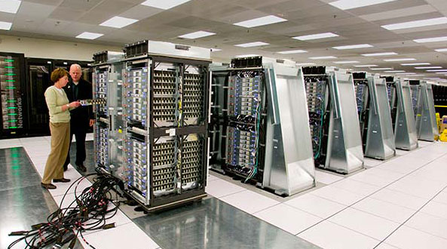
A Supercomputer
Lawrence Livermore National Laboratory by IBM

Slide 3
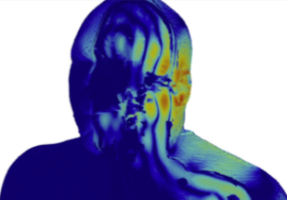

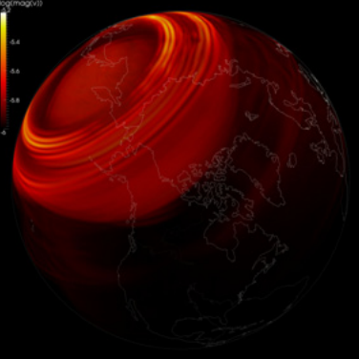
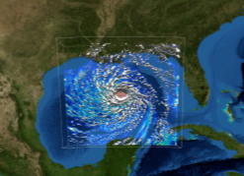
Supercomputer Applications
“Divisible” jobs
  Preserving data at archeological sites
  Modeling the human body
  Weather prediction
    Hurricanes
    Earthquakes
    Disaster relief

Slide 4
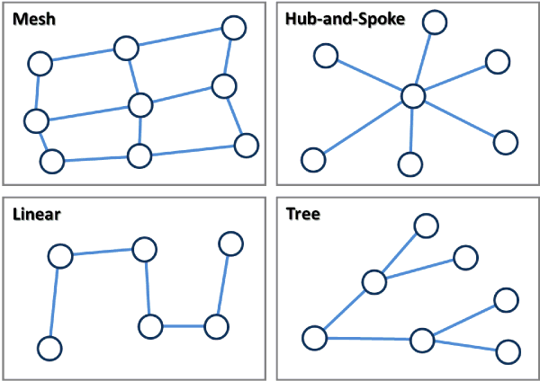
Interconnect Topologies
The arrangement of the elements of a computer network
  Processors (nodes)
  Connections (edges) between them
Many common topologies, some shown at right.

Slide 5
What is Dragonfly?
Introduced in 2008 by scientists at Stanford University and Cray Inc.

Slide 6
What is Dragonfly?
Introduced in 2008 by scientists at Stanford University and Cray Inc.
Nodes are connected to routers
Node 0
Node 1
Router
(directs network traffic)
Outgoing ports

Slide 7
What is Dragonfly?
Introduced in 2008 by scientists at Stanford University and Cray Inc.
Nodes are connected to routers
Routers are connected in groups of equal size
  Fully connected within groups
  “Virtual router”
0
1
Router
Group
0
1
0
1
0
1
0
1
Router
0
Router
1
Router
2
Router
3
Local channels
Outgoing ports

Slide 8
What is Dragonfly?
Introduced in 2008 by scientists at Stanford University and Cray Inc.
Nodes are connected to routers
Routers are connected in groups of equal size
  Fully connected within groups
  “Virtual router”
0
1
Router
Virtual Router
Acts like a single, larger router instead of components
0
1
0
1
0
1
0
1
Router
0
Router
1
Router
2
Router
3
Outgoing ports

Slide 9
What is Dragonfly?
Introduced in 2008 by scientists at Stanford University and Cray Inc.
Nodes are connected to routers
Routers are connected in groups of equal size
  Fully connected within groups
  “Virtual router”
0
1
Router
Group
0
1
0
1
0
1
0
1
Router
0
Router
1
Router
2
Router
3
Local channels
Outgoing ports

Slide 10
What is Dragonfly?
Introduced in 2008 by scientists at Stanford University and Cray Inc.
Nodes are connected to routers
Routers are connected in groups of equal size
  Fully connected within groups
  “Virtual router”
Groups of routers are connected to each other
  One edge between each pair of groups
Group
0
1
Router
0
1
2
3
Global channels
Dragonfly

Slide 11
A Simple Dragonfly
2 nodes/router
4 routers/group
9 groups
*Cables not shown for clarity

Slide 12
A Simple Dragonfly
From this node…
A sample communication path…
…to this node.

Slide 13
A Simple Dragonfly
Hop Count: 0
The groups are connected with a global channel here.
A sample communication path…

Slide 14
A Simple Dragonfly
Hop Count: 1
Travel to the appropriate router via local channels.
A sample communication path…

Slide 15
A Simple Dragonfly
Hop Count: 2
Traverse the global edge.
A sample communication path…

Slide 16
A Simple Dragonfly
Hop Count: 3
(longest possible path)
Travel locally to destination router.
A sample communication path…

Slide 17
Compare to Mesh…
From this node…
Hop Count: 0
…to this node.
A sample communication path…

Slide 18
Compare to Mesh…
Hop Count: 0
The highlighted route is one path connecting these nodes.
A sample communication path…

Slide 19
Compare to Mesh…
Hop Count: 7
A sample communication path…

Slide 20
Compare to Mesh…
Hop Count: 3
Hop Count: 7

Slide 21
Compare to Mesh…
Hop Count: 3
Hop Count: 7
72 nodes
36 nodes

Slide 22
Why is Dragonfly better?
Virtual router has a very high radix (number of ports), which leads to reduced latency (time to send a message) and hop counts
  Global diameter of system is 1
  Overall diameter is 3
Scalable
Design minimizes necessary global channels, reducing cost significantly

Slide 23
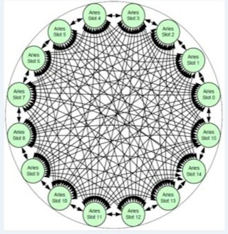
The Cabling Problem…
…or, why all the cables weren’t shown earlier.
Recent design, not yet produced
  Can cause some problems
How is a dragonfly machine actually cabled?

Slide 24
The Cabling Problem…
Does this configuration…
Does it matter which router in a group a global cable is connected to?
Do different cablings affect the machine’s performance, or do all cablings perform equally?
…perform the same as this one?

Slide 25
Two Main Cabling Patterns
Random cabling is OK but…
Absolute Cabling
Relative Cabling

Slide 26
Local naming
0 1 2 3

Slide 27
Global naming
(0,0)
1
0
2
(0,1)
8
3
7
4
6
5

Slide 28
Cabling
Virtual Router
Virtual Router
Virtual Router
1
0
2
8
Virtual Router
3
Virtual Router
7
4
Virtual Router
6
5
Virtual Router
Virtual Router
Virtual Router
*Local cables not shown for clarity

Slide 29
Absolute Cabling
1
0
2
8
3
7
4
6
5

Slide 30
Absolute Cabling
1
0
2
8
3
7
4
6
5

Slide 31
Absolute Cabling
1
0
2
8
3
7
4
6
5

Slide 32
Relative Cabling
1
0
(0)
2
(8)
(1)
(7)
8
3
(2)
(6)
7
4
(3)
(5)
6
(4)
5

Slide 33
Relative Cabling
1
0
2
8
3
7
4
6
5

Slide 34
Relative Cabling
1
0
2
8
3
7
4
6
5

Slide 35
Bisection Bandwidth Test
Bandwidth = 6
Definition:
If the network is segmented into two equal parts, this is the bandwidth between the two parts.

Slide 36


The Purpose
We want to find the worst-case
communication.

Slide 37
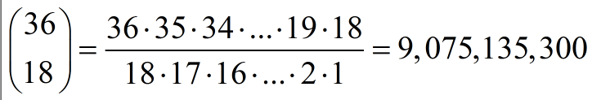
Split up
There will be a big enumeration…
For example, we can have 18 routers,
{(0,2),(1,1),(3,2) … (7,2),(8,0)}, in one set and the others in another set.

Slide 38
Relative Bandwidth
What about relative bandwidth? (i.e. considering global edges and local edges the same time)
Relative Bandwidth = local + global * α

Slide 39
Results
Total Score
α

Slide 40
Results
Total Score
α

Slide 41
Task Mapping
The process of assigning the tasks of a given job to available processors in the machine:
0
1
2
3
4
5
Job: 6 tasks
Machine, with available processors highlighted

Slide 42
Task Mapping
The process of assigning the tasks of a given job to available processors in the machine:
A possible mapping
0
1
2
3
0
1
2
3
4
4
5
5
Job: 6 tasks
Machine, with available processors highlighted

Slide 43
Task Mapping
The process of assigning the tasks of a given job to available processors in the machine:
A possible mapping
0
1
2
3
0
1
2
3
4
4
5
5
Job: 6 tasks
Machine, with available processors highlighted

Slide 44
Task Mapping
The process of assigning the tasks of a given job to available processors in the machine:
A possible mapping
5 hops
0
1
2
3
0
1
2
3
4
4
5
5
Job: 6 tasks
Machine, with available processors highlighted

Slide 45
Mapping on Dragonfly
Our idea: divide the job into sub-meshes, the same size as the dragonfly groups
  9 groups of 4
6 x 6 job
Job divided into 9 (2 x 2) sub-meshes

Slide 46
Mapping on Dragonfly
Want to try to match as many global edges on machine as possible to those on job
  Minimizes traffic by reducing hop counts of paths taken
Starting with one node per router and 2-D job meshes

Slide 47
Mapping on Dragonfly
0
0
1
2
8
1
3
4
5
7
2
6
7
8
6
3
5
4
Relative cabling, cables and processors not shown
All highlighted edges take 1 hop on machine
Machine
Job

Slide 48
Mapping on Dragonfly
This edge connects groups 0 and 1 in both the machine and job.
0
0
1
2
8
0
3
1
0
3
3
4
5
7
2
6
7
8
6
3
5
4
Relative cabling, cables and processors not shown
All highlighted edges take 1 hop on machine
Machine
Job

Slide 49
Mapping on Dragonfly
This edge connects groups 1 and 2 in both the machine and job.
0
0
1
2
8
0
3
0
3
1
0
0
3
3
4
5
7
2
3
6
7
8
6
3
5
4
Relative cabling, cables and processors not shown
All highlighted edges take 1 hop on machine
Machine
Job

Slide 50
Mapping on Dragonfly
Global edges
0
0
1
2
8
3
0
3
0
3
0
1
1
2
2
1
2
1
3
4
5
7
2
2
0
3
2
0
2
1
3
1
0
3
1
6
7
8
6
3
2
1
2
1
1
2
5
4
3
0
3
0
3
0
Relative cabling, cables and processors not shown
All highlighted edges take 1 hop on machine
Machine
Job

Slide 51
Mapping on Dragonfly
Global edges / Local edges
0
0
1
2
8
3
0
3
0
3
0
1
1
2
2
1
2
1
3
4
5
7
2
2
0
3
2
0
2
1
3
1
0
3
1
6
7
8
6
3
2
1
2
1
1
2
5
4
3
0
3
0
3
0
Relative cabling, cables and processors not shown
All highlighted edges take 1 hop on machine
Machine
Job

Slide 52
Mapping on Dragonfly
This mapping was done by hand
No obvious pattern
Want to find a more systematic approach, that can be adapted for jobs and machines of different sizes
0
1
2
3
0
3
0
3
0
1
2
2
1
2
1
3
4
5
2
0
3
2
0
2
1
3
1
0
3
1
6
7
8
2
1
2
1
1
2
3
0
3
0
3
0
All highlighted edges take 1 hop on machine
Job

Slide 53
Mapping on Dragonfly
Found 2 patterns that work when alternated
Better
  Finding single pattern unlikely
0
1
2
3
2
2
0
3
2
1
0
3
1
1
0
3
4
5
2
0
3
2
2
0
3
1
1
0
3
1
6
7
8
3
2
2
0
3
2
3
2
2
0
1
0
3
1
1
0
3
1
1
0
All highlighted edges take 1 hop on machine
Job

Slide 54
Future Plans
Working on mapping with absolute cabling
Will be comparing these styles of mapping to arbitrary placement of tasks
3D job meshes

Slide 55
Thanks for listening!

Slide 56
The Name
According to its creators, "The dragonﬂy name is used for the topology because of the dragonﬂy’s wide body but narrow wings – similar to the proposed topology with a large group but narrow channels connecting the groups."
Group (large)
Global channels (narrow)
Body (wide)
Wings (narrow)

Slide 57
Image Sources
http://markbw.com/id68.html
http://www.webestigate.com/2010/11/13/u-s-building-next-powerful-supercomputers/ibm_supercomputer/
http://www.tacc.utexas.edu/documents/13601/498275/DigitizingPast.pdf
http://www.tacc.utexas.edu/documents/13601/498275/WirelessWorries.pdf
http://www.tacc.utexas.edu/documents/13601/498275/CenteroftheStorm.pdf
http://www.tacc.utexas.edu/documents/13601/498275/EmergencyComputingJapan.pdf
http://people.hofstra.edu/geotrans/eng/ch1en/conc1en/typenettopo.html
http://www.theregister.co.uk/2012/11/08/cray_cascade_xc30_supercomputer?page=2

